Slide 1
Gaze Tracking Using A Webcamera
David Wild
Supervisor: James Connan
Rhodes University Computer Science Department

Slide 2
Contents:
What is Gaze Tracking?
Aim of Project
Quick Recap of Background
Design
Implementation
Results
Limitations
Future Work
Conclusion
Questions

Slide 3
What is Gaze tracking?
Track the gaze of a user
Different from Eye tracking, but includes it
Extended implementation of feature and object tracking
Notes:
Simply, it tracks the gaze of the user. It finds the area the user is focusing on visually.
Different from eye tracking: Eye tracking is keeping track of the eyes in an image. Gaze tracking incorporates this, as you’ll see.
Both eye and gaze tracking are feature and object detections systems but Gaze tracking takes it a step further.

Slide 4
Aim of Project
The Aim of my project was to create a gaze tracking system using a regular web-camera and OpenCV
To research whether it was possible to use a regular web-camera for Gaze Tracking

Slide 5
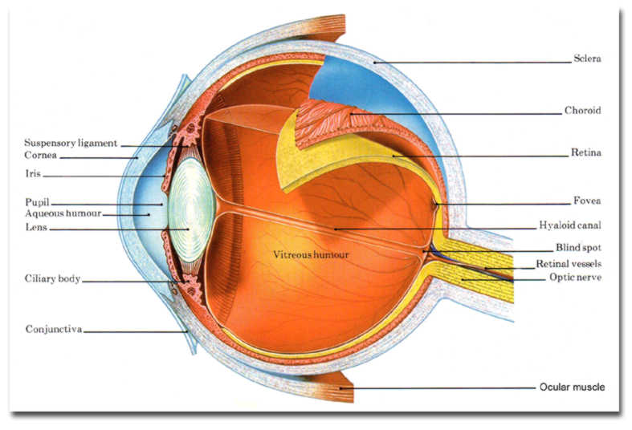
Background: Eye Structure
Notes:
The Eye moves in such a way that the focus point of our gaze is represented in the fovea. So naturally we want to find the fovea in the eye, but since it is at the back of the eye we can approximate its focus using the pupil instead. As such the pupil is the part of the eye itself that is necessary to find.

Slide 6
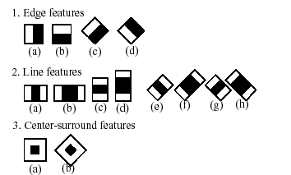
Background: Techniques
Haar Feature Detection
Uses dark and light areas to detect objects
OpenCV comes with several cascades already built in
Cascades are collections of features used to detect more complicated objects

Slide 7
Design
Input Image
Face Detection
Eye Detection
Pupil Location
Corner Location
Locate Gaze

Slide 8
Design(2)
Calibration first
Get reference points for later comparison
Necessary to provide reference to live points
Notes:
Calibration runs as the system would but gets the co-ordinates of specific points on the screen to use as a reference for the system
This is a necessary step to locate the gaze as it provides reference points to compare against the real time coordinates received.

Slide 9
Implementation
Done using OpenCV in a windows environment
Visual Studio 2010 C++ chosen
First hurdle: installing OpenCV
Second hurdle: Linking OpenCV in Visual Studio
Notes:
VC++ used because it is a popular choice for Windows users and did require the installation of separate C++ plugins to compile. This limits the system to a windows environment
The online documentation provided by OpenCV on installing it to Windows is incorrect for later versions. It is misleading and incomplete. Eventually found a blog that described the necessary steps although a few more were required along the way.
Once again the online documentation did not provide the correct method to do so but the blog did help and a week or so was spent getting that right.

Slide 10
Implementation(2)
Finally Coding:
Face detection done using HaarDetection
Used the built in HaarClassifier: haarcascade_frontalface_alt2.html
Reduce the Region of Interest (ROI)
Check each region for a eye using HaarDetection
Left Eye Classifier: haarcascade_lefteye_2splits.html
Right Eye Classifier: haarcascade_righteye_2splits.html
Notes:
Reduce the Region of Interest (ROI) by splitting the discovered face
Check each region for a eye (regions labeled left,right)

Slide 11
Implementation(3)
Reduce the ROI again
Pupil Detection
Equalise the histogram of the image
Binary Threshold
Smoothing
Canny Edge Detection
Finally, find circles using HoughCircle transform
Notes:
Reduce the ROI again, taking care to remove the eyebrows as they interfere with pupil detection
Pupil Detection:
Equalisation brightens and clears the image
Binary Threshold uses a threshold to make each pixel either white or black
Smoothing reduces noise
The edge detection is required to make the next step work. Also reduces noise
Finally, find circles using Circle Hough transform. Had a lot of trouble with houghcircles since it requires a lot of noise reduction. Took a lot of fine tuning.

Slide 12
Implementation(4)
Reduce the ROI again
Corner detection
Equalise the histogram of the image
cvGoodFeaturesToTrack
Notes:
Reduce the ROI again, to a small box encompassing only the inner corner of eye
Equalise the histogram to improve accuracy
Then use the function cvGoodFeaturesToTrack. The function finds corners in the search region. By tweaking the settings you can make it find the single strongest corner which in my ROI is the inner eye corner.

Slide 13
Implementation(5)
Now we have the corner and pupil coordinates in the image
Calibration
Nine Dots on black screen
Finds 80 coordinates for both pupils and both corners and then finds a consistent value to use as the point
Finds a single consistent coordinate for each dot out of the 80
Then we have comparative data
Notes:
So we have the two coordinates we can use the difference to calculate the gaze, but we need some comparative data.
Calibration:
Look at each dot until the program has stable data. Then allows clicks and can move on with click.

Slide 14
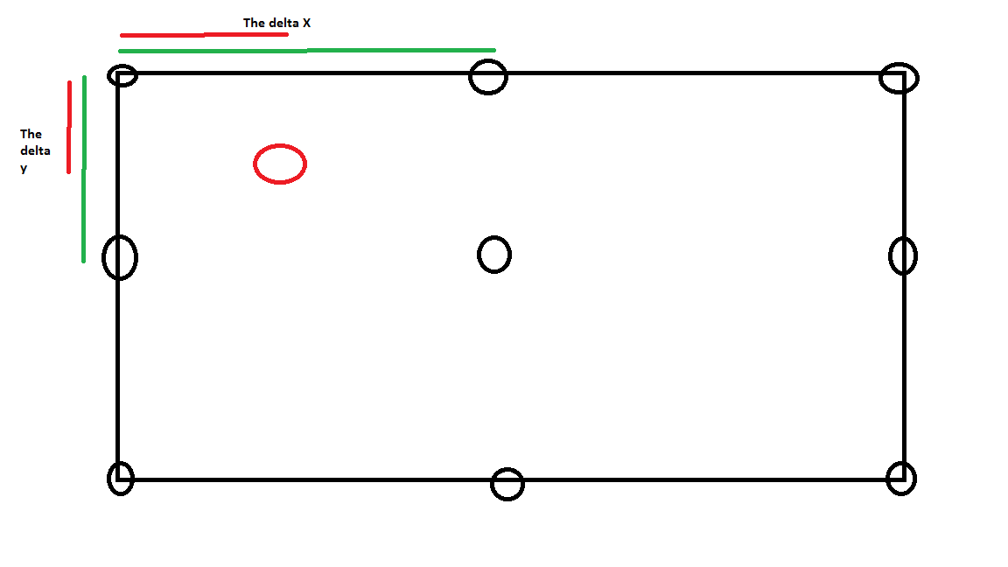
Implementation(6)
Compare calibrated data to live data
Uses ratio’s of differences between calibration points to approximate position
Repeat for both eyes
Notes:
Compare calibrated data to live data and try guess where you are looking
You get a ratio between the two delta x and then use that to approximate the position on the screen by multiplying the screen size by that ration.
Do this for x and y and then repeat for both eyes.
Use same size screen as calibration. Put a circle in the image. Measure. Click for new circle. Average the distances between actual circle centre and where the program thinks you are looking.

Slide 15
Implementation(7)
Obtaining Results
Measure distance from circle coordinates to approximated point
Notes:
Use same size screen as calibration. Put a circle in the image. Measure. Click for new circle. Average the distances between actual circle centre and where the program thinks you are looking.

Slide 16
Results
The system cannot do pinpoint accuracy.
Cannot accurately detect centre of the drawn circles
Notes:
The system cannot do pinpoint accuracy. If you draw a small circle, approximately 20mm big, the error is greater than the circle size

Slide 17
Limitations(1)
The Haar Cascades are not efficient or robust.
Haar cascades actually biggest problem for robustness
The Pupil Detection is not extremely accurate
Had to implement a stabiliser
Corner detection required very small ROI
Head movement creates error
The accuracy is not very good.
Has delay due to extreme processing
Notes:
The Haar cascades don’t always find the feature and are very limited in head orientation.
Because they use black and white features the Haar detection doesn’t find certain skin tones
Pupil detection:
Had to implement a stabiliser because otherwise the coordinates jumped all over the place
The corner detection required that I make the ROI around the inner eye corner extremely small.
The accuracy is not very good. Can get within a region only no pinpoint accuracy.
The system has Delay from all the processing I do.

Slide 18
Limitations(2)
The above limitations can be credited to:
My implementation
The techniques themselves
Design Choices
Surprisingly not due to Web-camera
Notes:
My implementation of this is simple. I have no doubt that there are more effective ways to implement even the same techniques.
The Haar Detection for example, another techniques could remove the limitations, (maybe Blink detection)
and I use simple techniques taken from the library and this means they aren’t as effective.
It was my choice to not incorporate head movement cancellation into the system as I was trying to keep the system as simple as possible
The webcamera I was using gave enough resolution to do the job. More powerful camera’s could obviously be more efficient but most applications are still possible with a simple webcamera.
Although I was originally using a cheap R50 webcamera borrowed from a friend which was not accurate enough. So a certain base level is required.

Slide 19
Future Work
Improve the efficiency
Compare Other Techniques
Use Infrared to simplify the eye and pupil detection
Remove the need for calibration
Incorporate head movement cancellation
Apply Gaze tracking to interesting applications
Webcam and Raspberry Pi
Research
Notes:
Applications:
Raspberry Pi is portable and mini. Can use it to find gaze or eye tracking in interesting places like for driving
Research: Even a slow system can be used for research If you adapt the program to work from video instead.
Studies done already include reading techniques
Surfing, Parkour and so much more

Slide 20
Conclusion
My system
It is not as accurate as I would like nor as robust
System not conclusive on applications but is suggestive
Research found that a regular web-camera can work accurately enough for Gaze tracking applications
Notes:
I would have preferred but to create a system that could accurately move the mouse to icons on the screen but I was unable to.
System not conclusive on applications with a regular web-camera but is suggestive since the techniques used were the issue not the camera’s quality
Research found that a regular web-camera can work accurately enough for Gaze tracking applications and many free systems are available online.

Slide 21
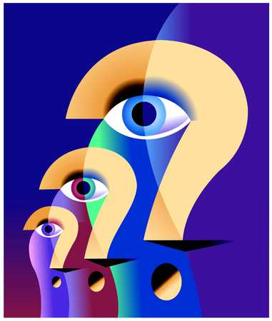
Questions?

